Slide 1
NFAs accept the Regular Languages
Courtesy Costas Busch - RPI

Slide 2


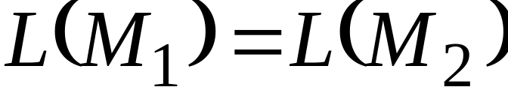
Equivalence of Machines
Definition for Automata:
Machine is equivalent to machine
if
Courtesy Costas Busch - RPI

Slide 3

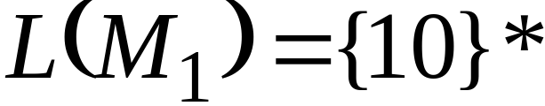




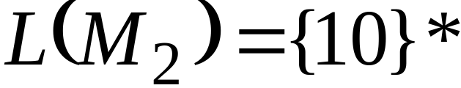

Example of equivalent machines
NFA
DFA
Courtesy Costas Busch - RPI

Slide 4

We will prove:
Languages
accepted
by NFAs
Regular
Languages
Languages
accepted
by DFAs
NFAs and DFAs have the
same computation power
Courtesy Costas Busch - RPI

Slide 5


Proof:
we only need to show
Languages
accepted
by NFAs
Regular
Languages
AND
Languages
accepted
by NFAs
Regular
Languages
Courtesy Costas Busch - RPI

Slide 6

Step 1
Languages
accepted
by NFAs
Regular
Languages
Proof:
Every DFA is trivially an NFA
Any language accepted by a DFA
is also accepted by an NFA
Courtesy Costas Busch - RPI

Slide 7
Step 2
Languages
accepted
by NFAs
Regular
Languages
Proof:
Any NFA can be converted to an
equivalent DFA
Any language accepted by an NFA
is also accepted by a DFA
Courtesy Costas Busch - RPI

Slide 8





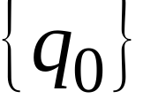
Conversion NFA to DFA
NFA
DFA
Courtesy Costas Busch - RPI

Slide 9
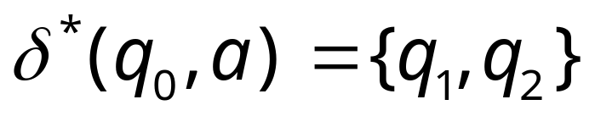
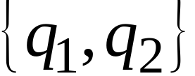
NFA
DFA
Courtesy Costas Busch - RPI

Slide 10
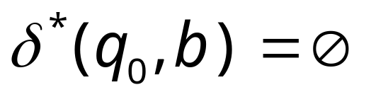

empty set
NFA
DFA
trap state
Courtesy Costas Busch - RPI

Slide 11
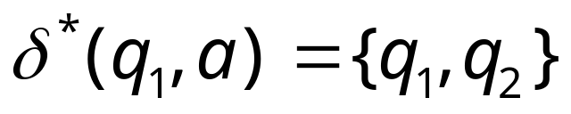
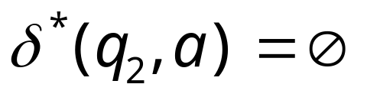
NFA
union
DFA
Courtesy Costas Busch - RPI

Slide 12
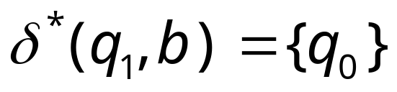
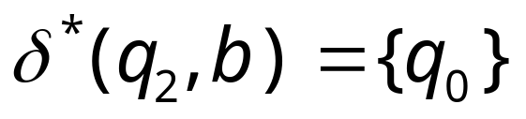
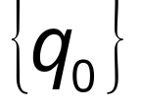
NFA
union
DFA
Courtesy Costas Busch - RPI

Slide 13

NFA
DFA
trap state
Courtesy Costas Busch - RPI

Slide 14
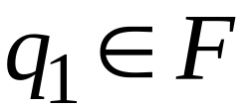
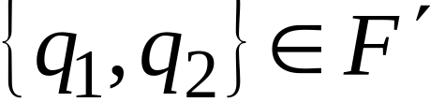
END OF CONSTRUCTION
NFA
DFA
Courtesy Costas Busch - RPI

Slide 15
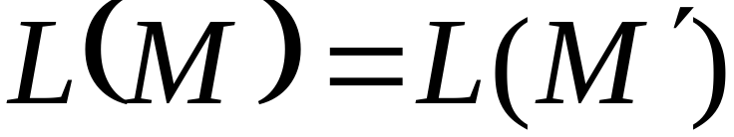
Convert NFA to DFA
NFA
DFA
Courtesy Costas Busch - RPI

Slide 16
General Conversion Procedure
Input: an NFA
Output: an equivalent DFA
with
Procedure: subset construction
Courtesy Costas Busch - RPI

Slide 17
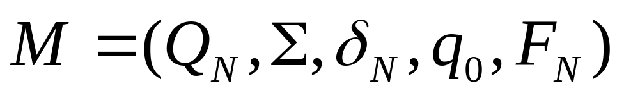
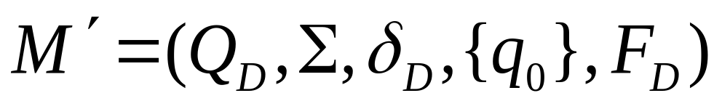
NFA to DFA: Formally
We are given an NFA
We want to convert it
to an equivalent DFA
With
Courtesy Costas Busch - RPI

Slide 18
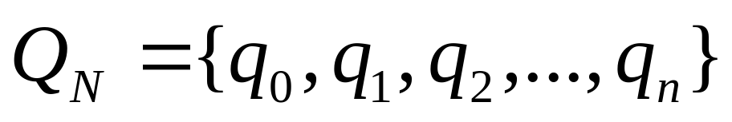
If the NFA has n states
the DFA has 2^{n} states in the power set of Q_{N}
i.e.
Courtesy Costas Busch - RPI

Slide 19
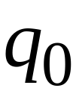
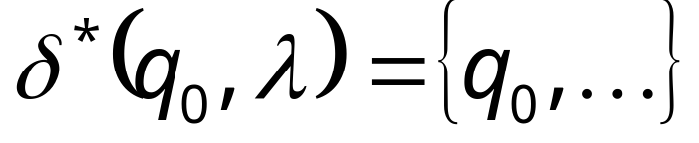
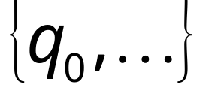
Procedure NFA to DFA
1. Initial state of NFA:
Initial state of DFA:
Courtesy Costas Busch - RPI

Slide 20
Example
NFA
DFA
Courtesy Costas Busch - RPI

Slide 21
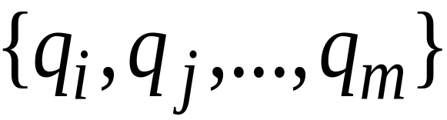
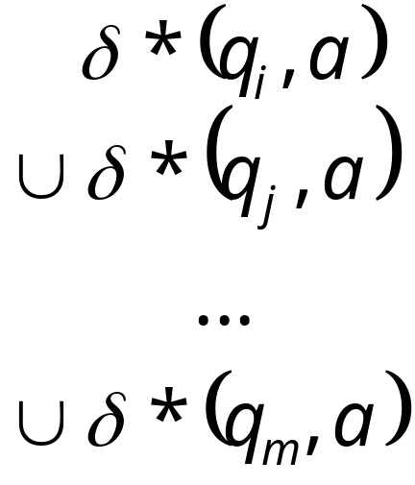

Procedure NFA to DFA
2. For every DFA’s state
Compute in the NFA
Add transition to DFA
Union
Courtesy Costas Busch - RPI

Slide 22
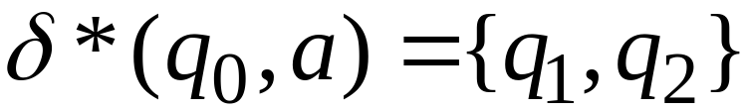
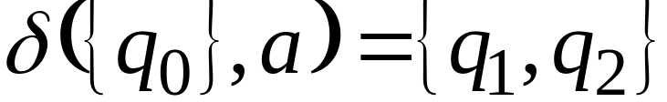
Example
NFA
DFA
Courtesy Costas Busch - RPI

Slide 23
Procedure NFA to DFA
Repeat Step 2 for all letters in alphabet, until no more transitions can be added.
OR
Repeat Step 2 for every state in DFA and symbols in alphabet until no more states can be added in the DFA
Courtesy Costas Busch - RPI

Slide 24
Example
NFA
DFA
Courtesy Costas Busch - RPI

Slide 25

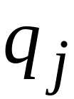
Procedure NFA to DFA
3. For any DFA state
If some is a final state in the NFA
Then,
is a final state in the DFA
Courtesy Costas Busch - RPI

Slide 26
Example
NFA
DFA
Courtesy Costas Busch - RPI

Slide 27


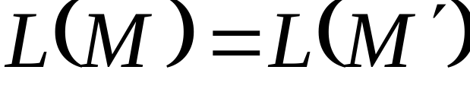
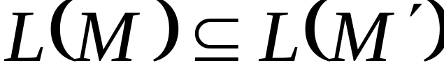
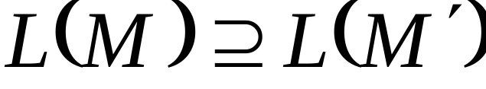
Lemma:
If we convert NFA to DFA
then the two automata are equivalent:
Proof:
We only need to show:
AND

Slide 28
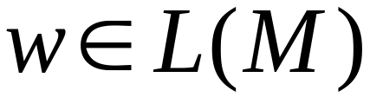
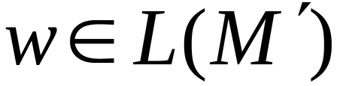
First we show:
Take arbitrary:
We will prove:
Courtesy Costas Busch - RPI

Slide 29




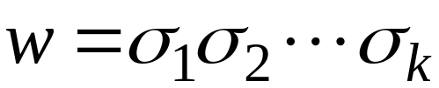



Courtesy Costas Busch - RPI

Slide 30





NOTE:
symbol
denotes a possible sub-path like
symbol

Slide 31


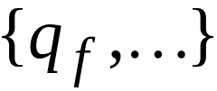
We will show that if
Courtesy Costas Busch - RPI

Slide 32

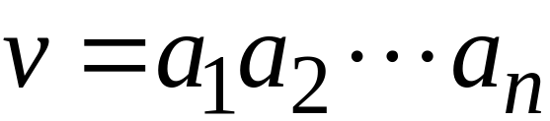











More generally, we will show that if in :
(arbitrary string)
Courtesy Costas Busch - RPI

Slide 33
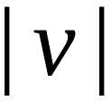
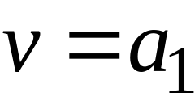
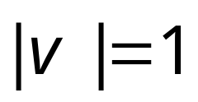

Proof by induction on
Induction Basis:
is true by construction of
Courtesy Costas Busch - RPI

Slide 34
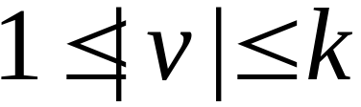
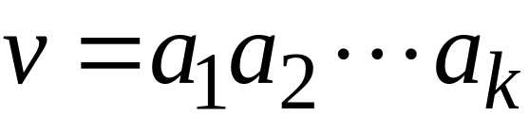





Induction hypothesis:
Courtesy Costas Busch - RPI

Slide 35
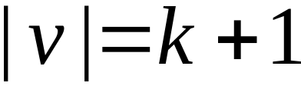
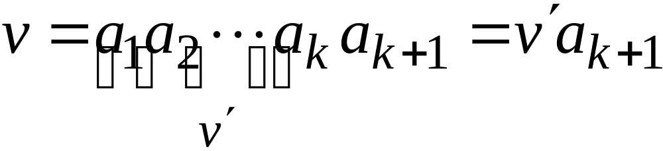

Induction Step:
Courtesy Costas Busch - RPI

Slide 36



Induction Step:
Courtesy Costas Busch - RPI

Slide 37
Therefore if
Courtesy Costas Busch - RPI

Slide 38
We have shown:
We also need to show:
(proof is similar)
Courtesy Costas Busch - RPI

Slide 39

Activity
Time
NFAs vs. DFAs

Slide 40
NFAs vs. DFAs
What is non-determinism?
Which is useful?
Which is powerful?

Slide 41
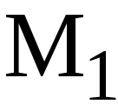
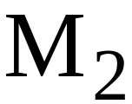
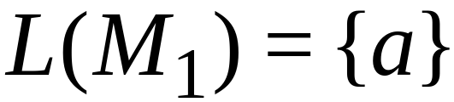
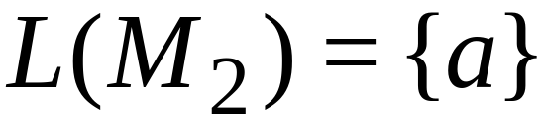
NFAs are interesting because we can
express languages easier than DFAs
NFA
DFA
Courtesy Costas Busch - RPI

Slide 42
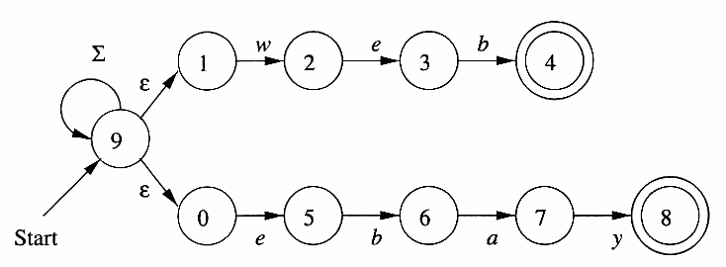

Slide 43
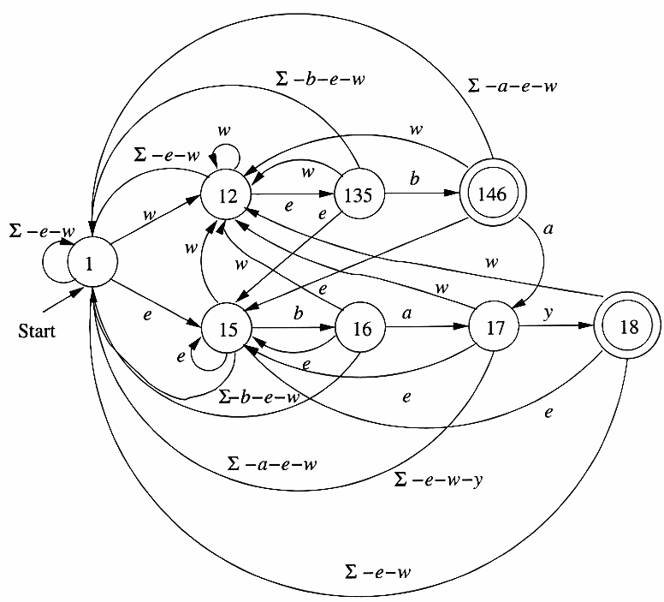



Slide 44
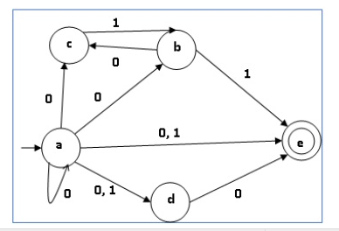
Home task
Courtesy Costas Busch - RPI

Slide 45
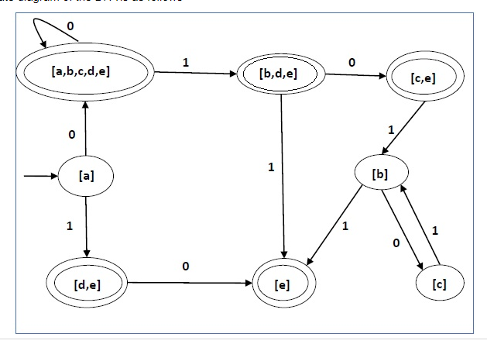
Solution
Courtesy Costas Busch - RPI

Slide 46
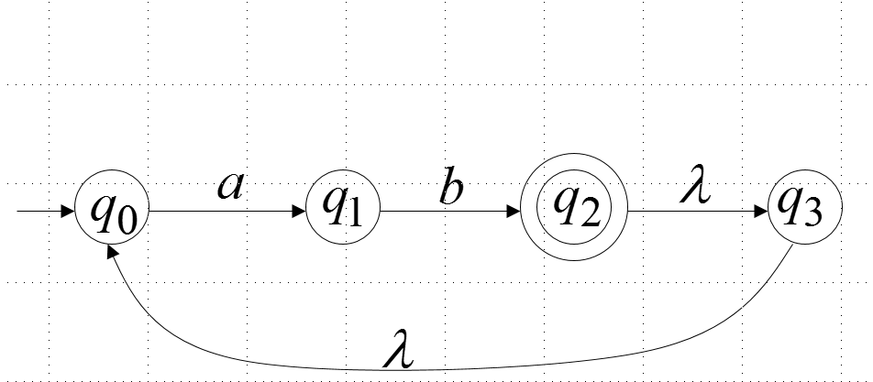
Epsilon NFA to DFA AND NFA
Courtesy Costas Busch - RPI

